Slide 1
www.sec.vt.edu
Student Engineers’ Council
Everything You Need to Know

Slide 2
www.sec.vt.edu
Fall Semester Events
Engineering Expo
Wine and Cheese Reception
Leadership In Engineering Conference
Freshman Major Mixer

Slide 3
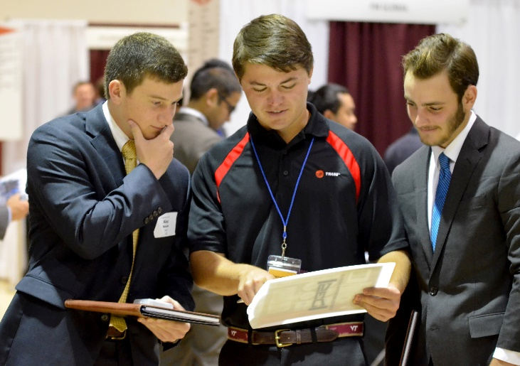
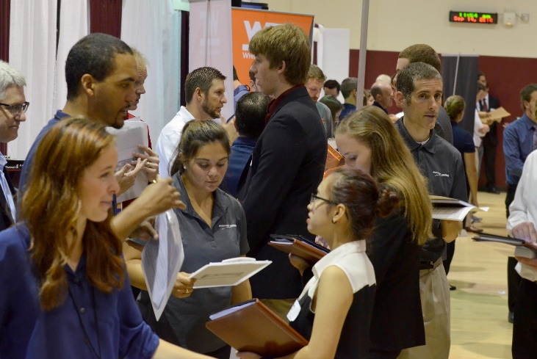
www.sec.vt.edu
Engineering Exposition
What is it: Virginia Tech’s Fall Engineering Career Fair
Who attends: Over 275 companies and 5,000 students attend each year
When is it: A consecutive Tuesday and Wednesday in the middle of September
Where is it held: Squires Ballroom, Squires Colonial Ballroom, and Owens Banquet Hall (in Hokie Grill)
How you can get involved as an organization:
Volunteer Opportunities
Shuttle Drivers
Check-In
General

Slide 4
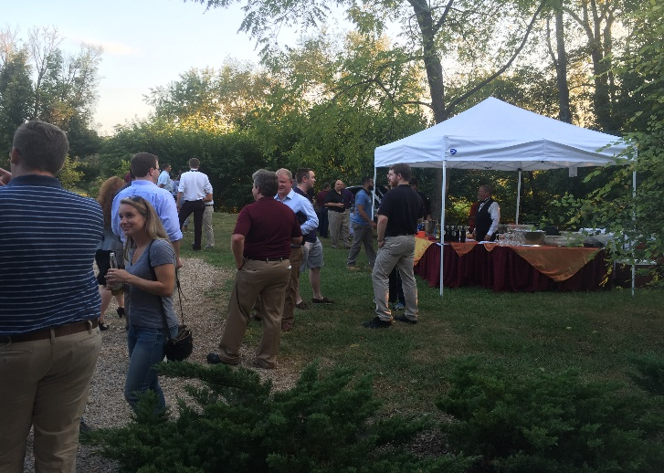
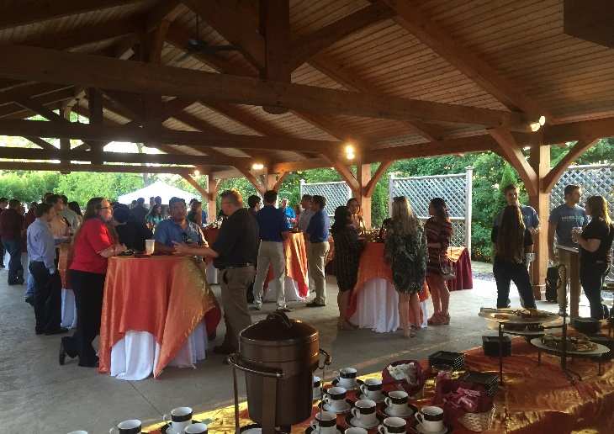
www.sec.vt.edu
Wine and Cheese Reception
What is it: Catered reception to let companies attending Expo relax and experience more of Virginia Tech
Who attends: Expo company representatives in addition to select design teams and students
When is it: Tuesday afternoon of Expo week
Where is it held: A large open space venue that highlights Virginia Tech (German Club Manor, Goodwin Atrium, Smithfield Plantation)
How you can get involved as an organization:
Bring design project to display at event
Talk to SEC executive board for possibilities to attend event as a team or individual

Slide 5
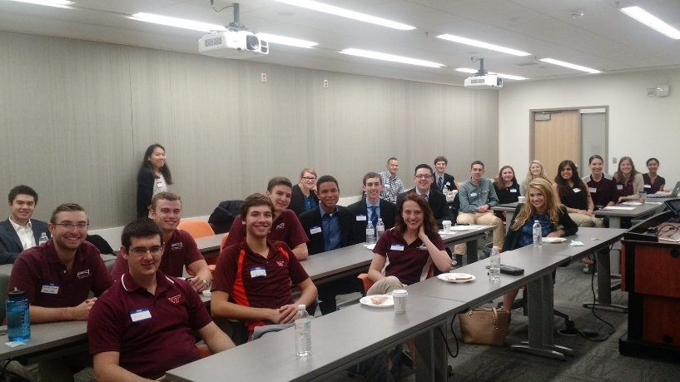
www.sec.vt.edu
Leadership In Engineering Conference
What is it: Leadership conference that combines industry leading companies and esteemed guest speakers with Virginia Tech’s finest engineering students. Involves opening speeches, 3 breakout sessions with companies of your choice and wraps up with a breakout session to talk to company recruiters.
Who attends: Around 6 companies, 2 speakers, and around 200 students
When is it: Fall Break or another weekend in October
Where is it held: Goodwin Atrium
How you can get involved as an organization:
Attend conference as a team or an individual

Slide 6
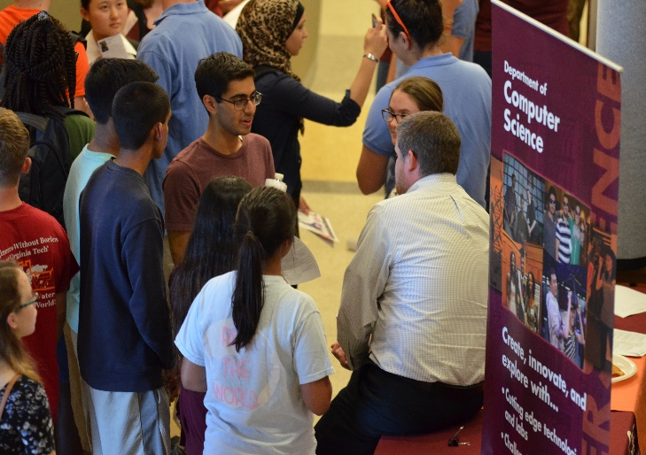
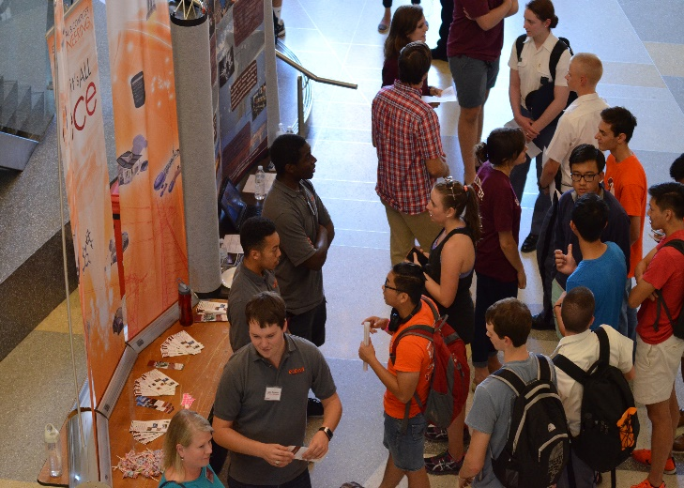
www.sec.vt.edu
Freshman Major Mixer
What is it: An opportunity for freshman to learn more about each engineering major and the organizations they could get involved with each major to help them decide on career paths
Who attends: Freshman engineers, design teams, engineering organizations, representatives from each engineering major
When is it: October
Where is it held: Goodwin Atrium
How you can get involved as an organization:
Show up early to help with set up
Set up an informational booth highlighting your organization and how an underclassman could get involved

Slide 7
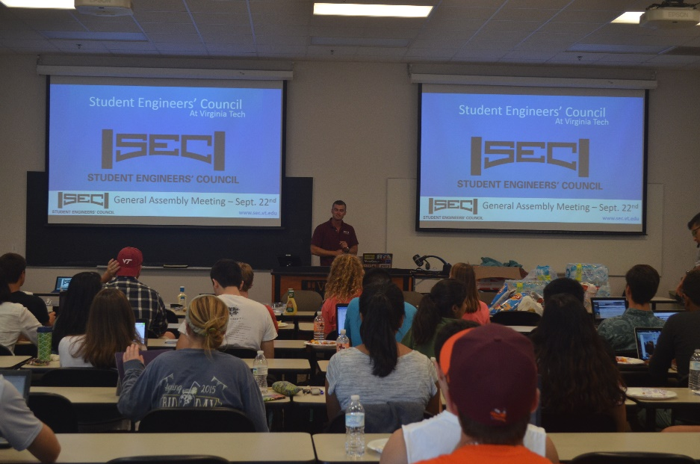
www.sec.vt.edu
Fall Semester GAMs
Freshman
Semester Ahead
Design Team Endowment
Engineering Organization Fund
Budget
Constitution
(All GAM dates are online at http://www.sec.vt.edu/calendar.html)

Slide 8
www.sec.vt.edu
Fall Available Positions
September - Freshman Chair
December - Engineering Expo Chair

Slide 9
www.sec.vt.edu
Spring Semester Events
Awards and Scholarships Banquet
E-Week
Drillfield Organization Showcase
Guest Speaker/Academic Event
Team Competition
Social Events

Slide 10
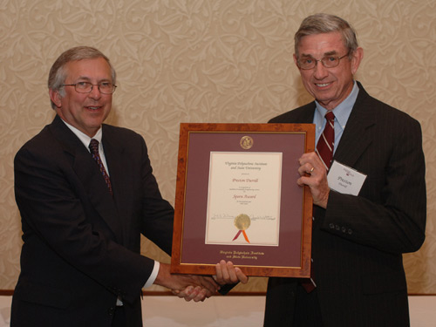
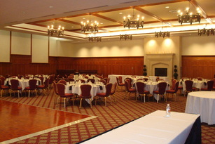
www.sec.vt.edu
Awards and Scholarships Banquet
What is it: Banquet to honor the winners of the Paul E. Torgersen Leadership Scholarships, Nathanael Gebreyes Service Scholarship, College of Engineering Sporn Award, Undergraduate Research Advisor Award, Engineering Organization Advisor Award and the Engineering Organization Award.
Who attends: Award and scholarship recipients, esteemed faculty and select students
When is it: Mid-March
Where is it held: Owens Banquet Hall
How you can get involved as an organization:
Contact the SEC executive board as to how to attend event as organization or individual

Slide 11
www.sec.vt.edu
Student Scholarships
Paul E. Torgersen Leadership Scholarship
Nathaniel Gebreyes Service Scholarship
Requirements:
minimum 2.5 gpa
1 essay required
1 letter of reference required
must be a rising senior
Scholarship prize: $1,250 per winner
. Deadline: March 3rd, 2017 at 11:59pm
Requirements:
minimum 3.0 gpa
1 essay required
1 letter of reference required
must be a rising junior or senior
Scholarship prize: $1,250
. Deadline: March 3rd, 2017 at 11:59pm
Notes:
-the torg leadership scholarship is awarded to two rising senior students who has shown outstanding leadership and academic achievement
-in order to apply, you must have a 2.5 gpa, get a letter of reference, and write an essay--the prompt, and the applications for both of these scholarships are under the forms tab on the SEC’s homepage on gobblerconnect.
-the gebreyes service scholarship is awarded to one rising junior or senior who has portrayed outstanding service principles to the university and the community -you must be a rising junior or senior, as long as you have at least two semesters left, you also need an essay and letter of reference, but the gpa requirement is a little higher--you’ve gotta have a 3.0 to qualify.
-the deadlines for both of these scholarships is March 3rd, Friday at midnight.

Slide 12
www.sec.vt.edu
Faculty Awards
Sporn Award: awarded to an engineering faculty member who has demonstrated excellence in undergraduate instruction ($250)
Undergraduate Research Advisor Award: awarded to a faculty member that goes above and beyond in advising and mentoring students during the undergraduate research process ($250)
Engineering Organization Advisor Award: awarded to a faculty member that has made outstanding commitments to a design team within the College ($250)
Nomination Process:
nominate your advisors and professors using the forms on the SEC’s gobblerconnect homepage
(Monday Jan 23rd--Friday Mar 24th)
Awards & Scholarships Committee select the top five candidates to present to the SEC at GAM
students who submitted nominations may speak briefly on behalf of their preferred candidate GAM, then SEC will take a vote
winners will be awarded at Awards & Scholarships Banquet

Slide 13
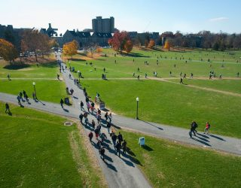
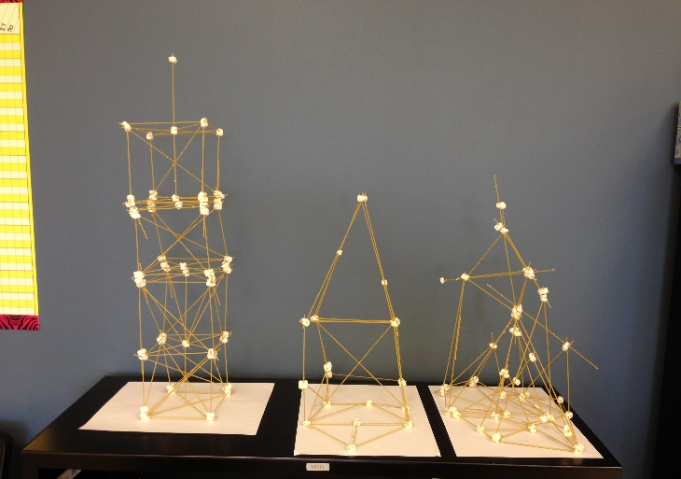
www.sec.vt.edu
E-Week
What is it: Final celebratory week to celebrate engineering as a college-wide community. Composed of a Drillfield showcase, team competition, social events, and academic opportunities
Who attends: All engineers including design teams, engineering organizations, faculty, and guest speakers
When is it: March
Where is it held: Multiple venues around Virginia Tech
How you can get involved as an organization:
Set up a booth and fun activity during the Drillfield showcase
Participate (and hopefully win!) the team competition
Attend social and academic events

Slide 14
www.sec.vt.edu
E-Week Breakdown
Notes:
Tuesday and Wednesday could switch (Career Services are being annoying and not getting back to me)
Throughout the week will be sending out challenges on twitter (ex. Clues to find SEC logos hidden on campus), challenges like getting a picture with an exec member will be worth points
Casey was coming up with a point breakdown of how many points winning e-week would be worth which would then be added towards point total for design team award which will be a ($1000 prize). Will win a trophy if win eweek
Email out packet to each design team on point breakdown and all specifics as we get closer so that they each know exactly what to expect.
Overall, emphasize the competition aspect amongst design teams

Slide 15
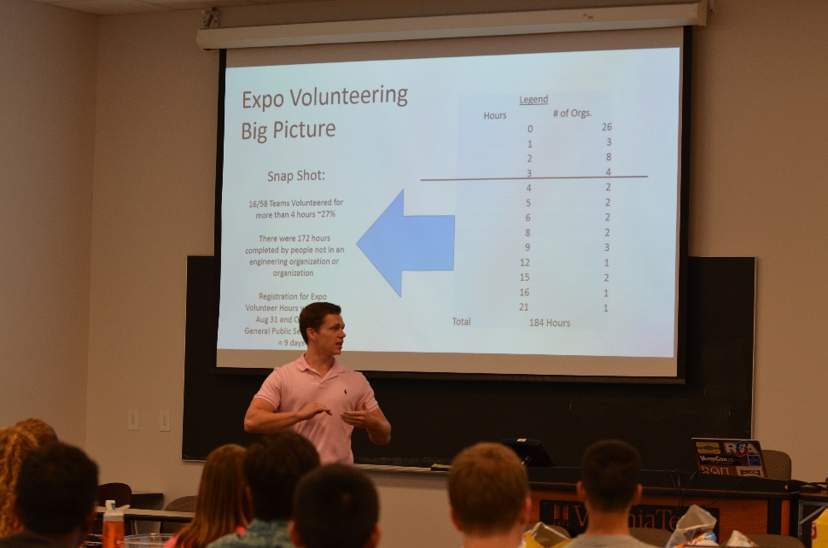
www.sec.vt.edu
Spring Semester GAMs
Welcome Back
Design Team Endowment
Engineering Organization Fund
Big Contribution
Awards
Director Election
(All GAM dates are online at http://www.sec.vt.edu/calendar.html)

Slide 16
www.sec.vt.edu
Spring Available Positions
January – Leadership in Engineering Conference Chair
April – All Director Positions (President, Vice President, Finance, Administration, Philanthropy, Relations)
April – Membership Enrichment Chair, Information Management Chair, Publicity Chair, Awards and Scholarships Chair, and E-Week Chair

