Slide 2
Welcome to GAM #1
Spring Semester Overview

Slide 3
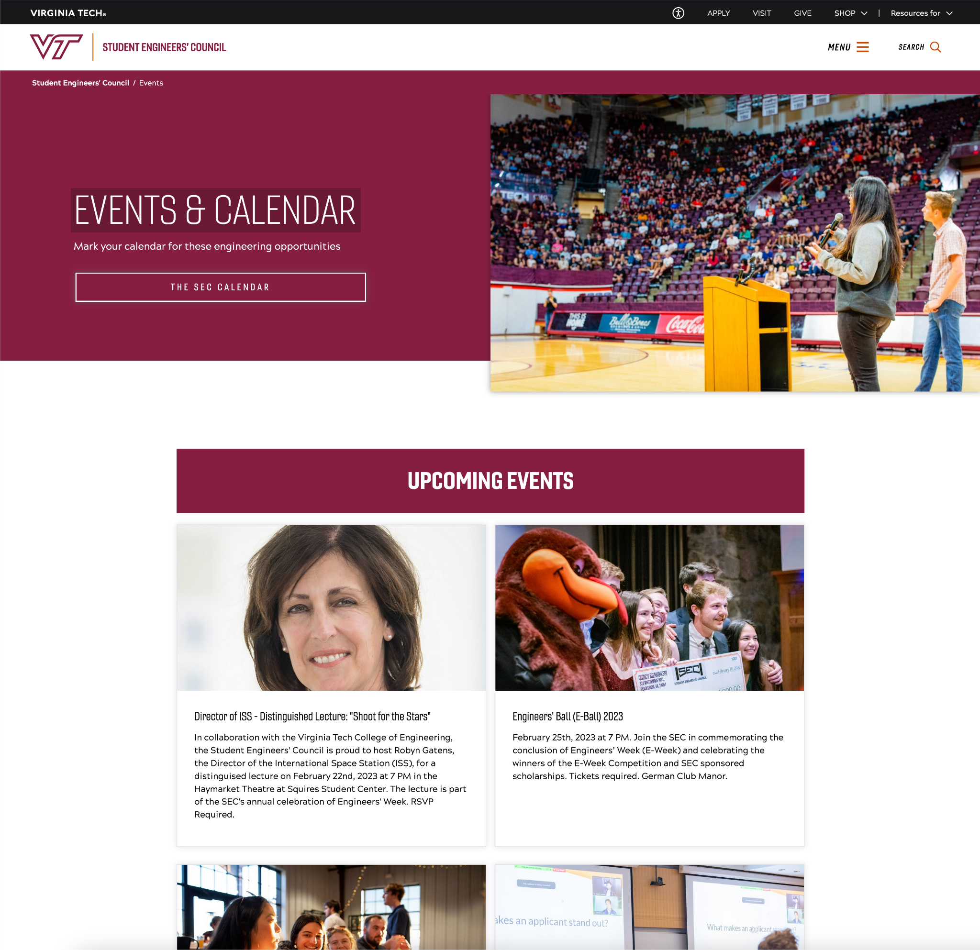
Events & Calendar
Major Events
Calendar
General
Director Office Hours
A great resource!

Slide 4
Spring Semester Events Overview

Slide 5
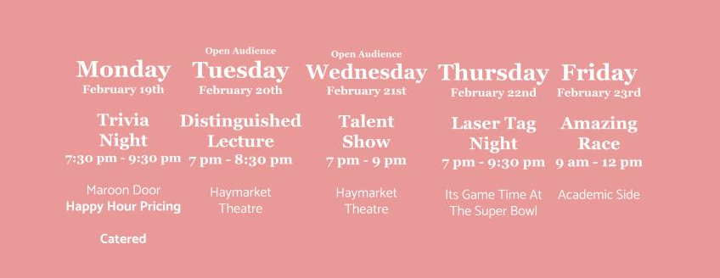
E-Week
Team registration on sec.vt.edu/eweek

Slide 6
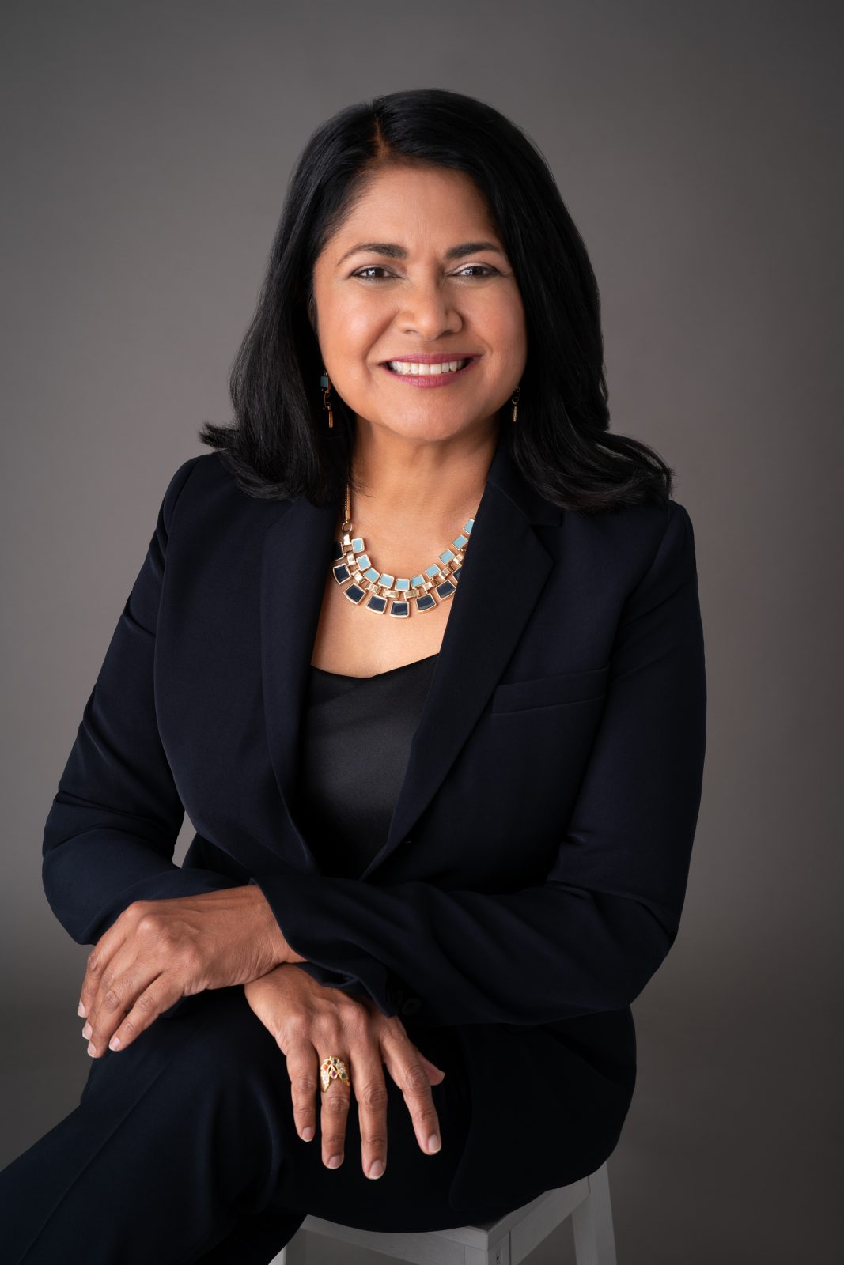
Featured: “Arriving at a Gestalt” Lecture
AI Adoption
Digital Innovation
Virginia Tech Grad
TEDx Speaker
Global Head of PAIR
at Electronic Arts
Ph. D and M.S. degrees
in Mechanical Engineering from Virginia Tech

Slide 7
Scholarships: due Feb 4th!
Torgersen Leadership Scholarship - $2k to 2 students ($4k total)
Supporting student leaders within the College of Engineering
Gebreyes Service Scholarship - $2k to 2 students ($4k total)
Supporting students who exhibit great service, on or off campus
Applications & Letters of Recommendation due February 4th
***SEC Scholarship and Watford Scholarship will be released later in the semester

Slide 8
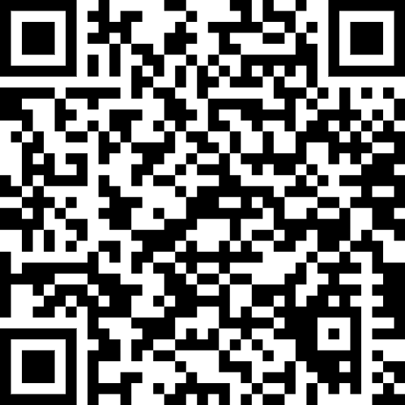
Awards: Nominate your favorites!
Nominate faculty to win $3,000 worth of awards dedicated to exemplary research advising, organization advising, and classroom instruction.
Research Advisor Award - $500 research grant
Awarded to an exemplary faculty member advising students on research
Organization Advisor Award - $500 organization grant
Awarded to an exemplary faculty member advising a student organization
College of Engineering Sporn Award - $2k bonus paid by VT
Awarded to a faculty member demonstrating excellence in the classroom
All nominations due February 4th

Slide 9
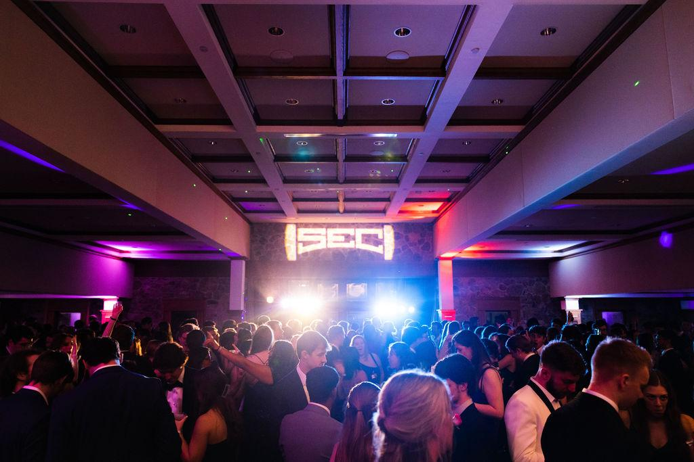
E-Ball
Tickets go on sale Friday @ 3pm
March 23rd
German Club Manor

Slide 10
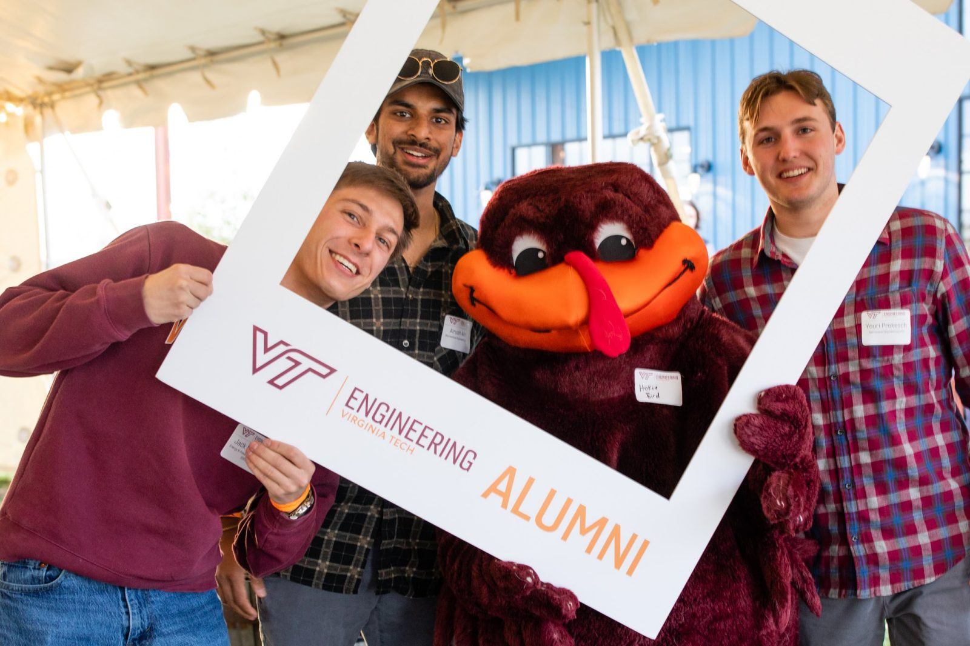
Hokie Engineer Launch Party
When: April 11
Where: Eastern Divide Brewery
What: a fun evening to celebrate making it through VT Engineering with your fellow senior classmates!

Slide 11
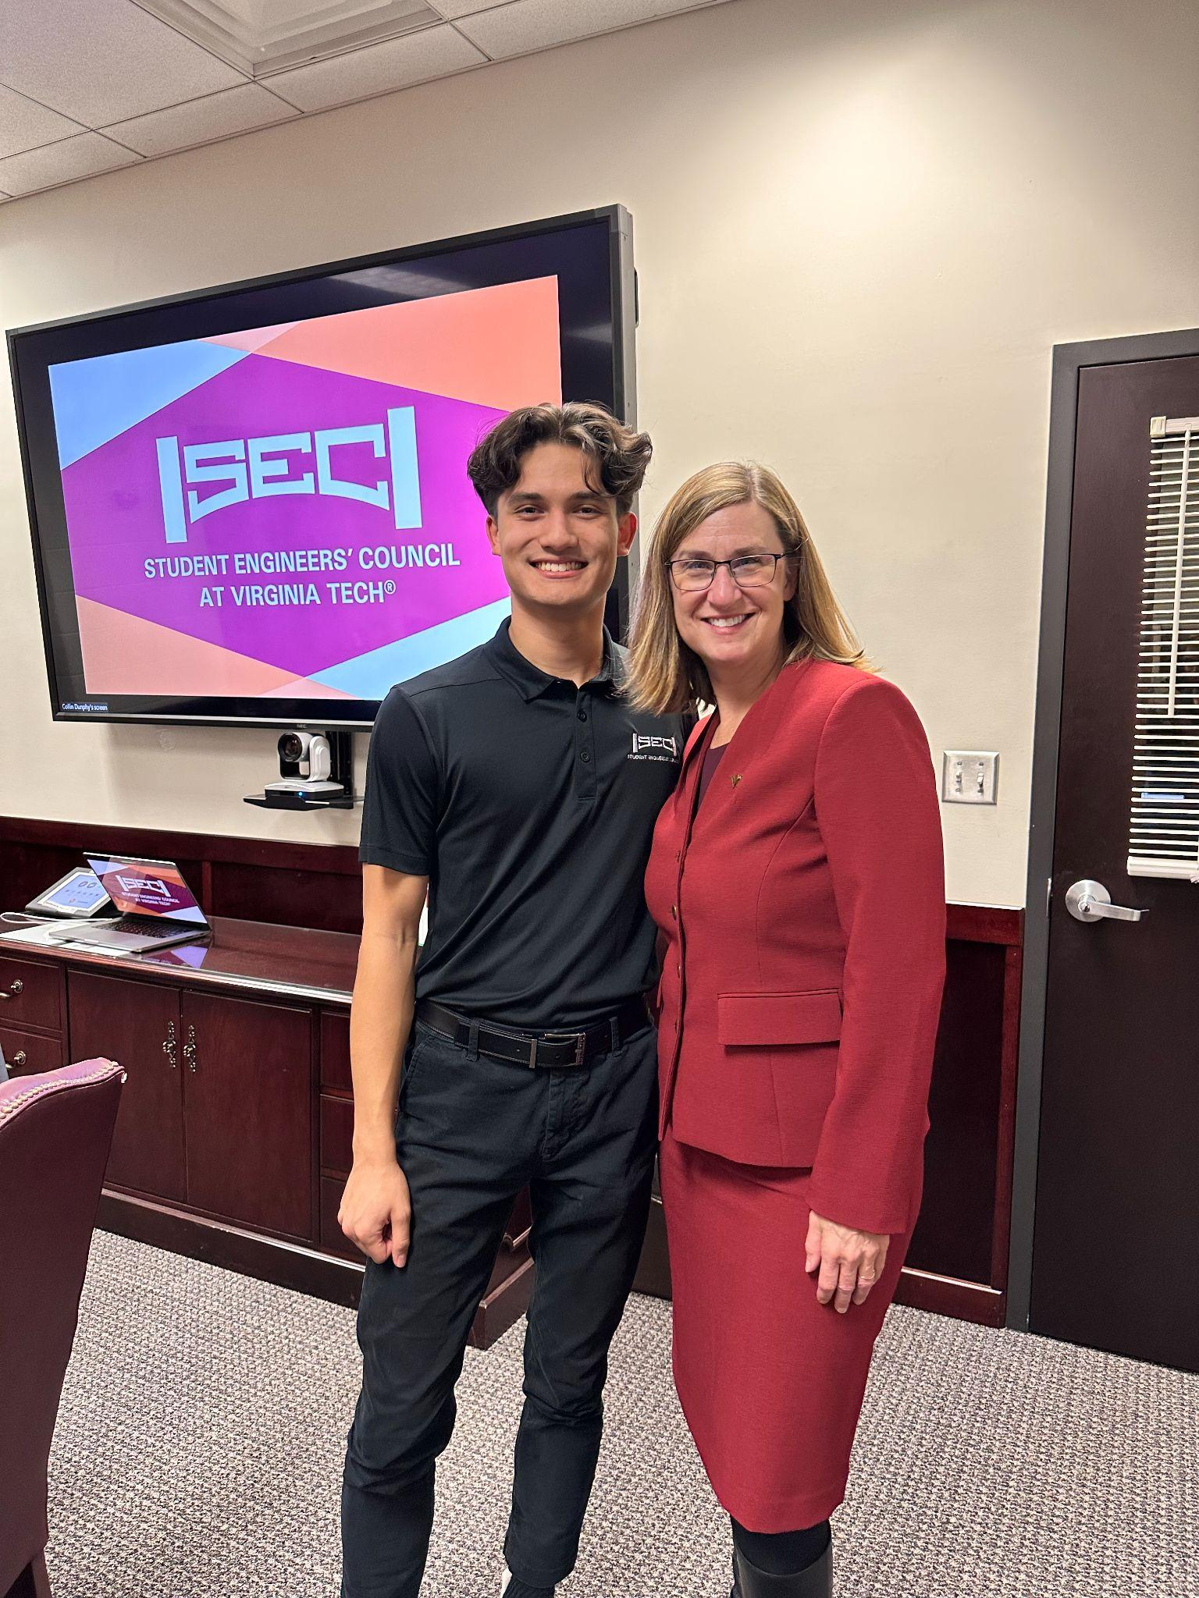
Meet the Dean
Opportunity to connect with Dean Ross
Talk about your experience in the College of Engineering
February 15 at 4-5 pm
April 23 at 3:30-4:30 pm
Refreshments will be provided!

Slide 12
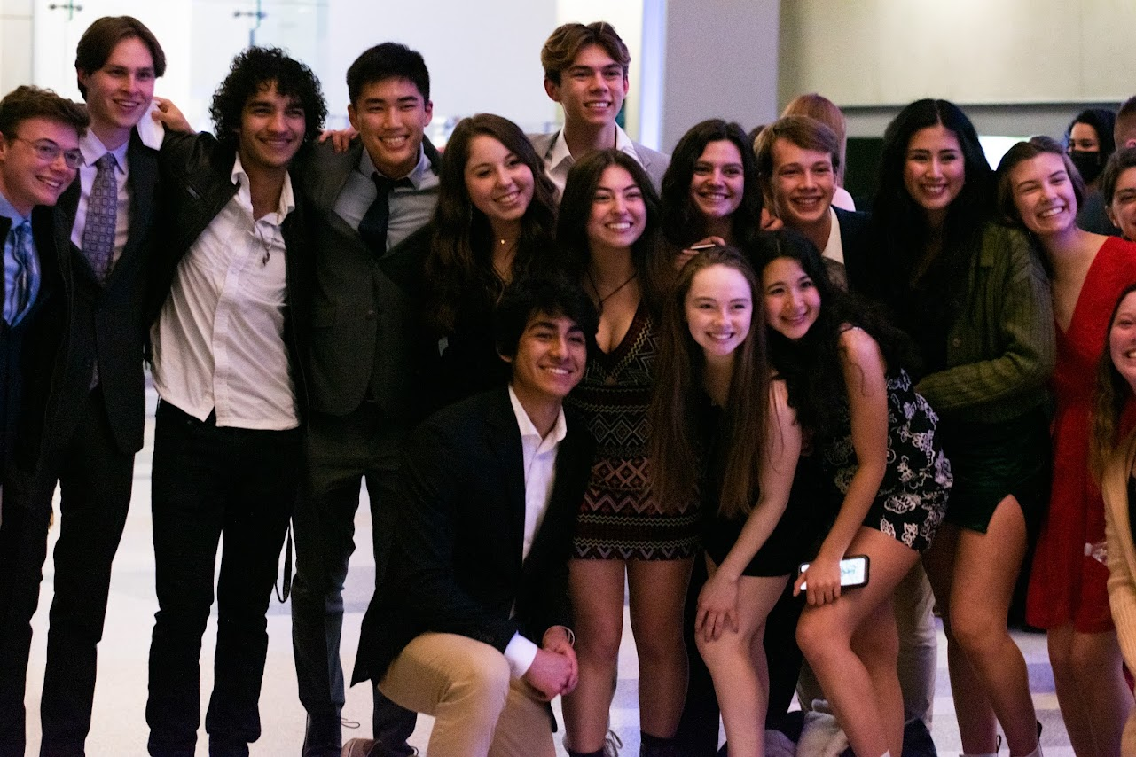
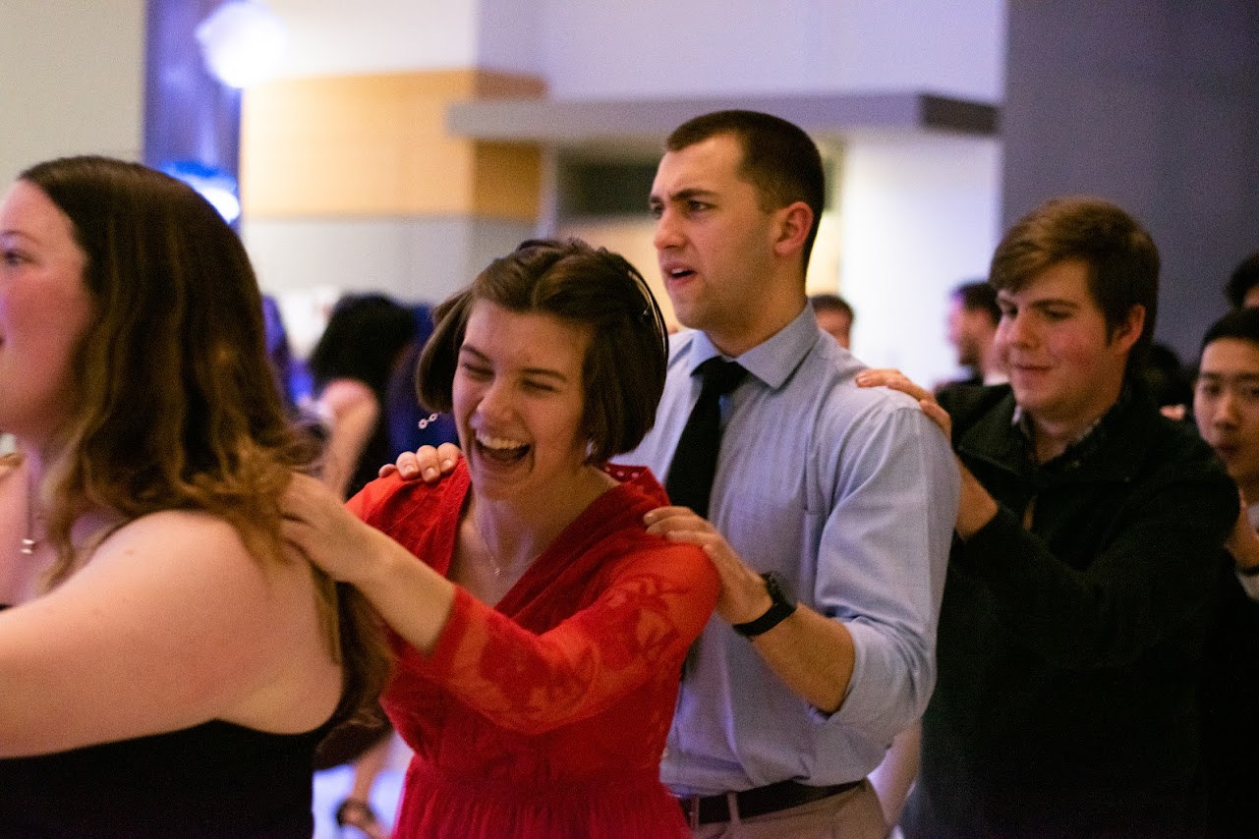
Major Mixer
Date: Wednesday March 13
Time: 6 - 7:30 PM
Location: Commonwealth Ballroom in Squires
Freshman Formal
Date/Time/Location: TBD

Slide 13
Social Media
Follow our Instagram page and stay up to date on events, important dates, etc.

Slide 14
EOF AND LNF!!

Slide 15
Foundation Accounts FAQ
What is a foundation account?
Serves as a bank account managed by VT
No foundation account?
Reach out to advisor and utilize their accounts OR create your own account
How do we check if we are using a foundation account?
Six digit # starting with 86****, 87****, or 88****
How to report a transfer?
“8xxxxx with a final destination of 8yyyyy”
Who needs a foundation account?
REQUIRED for all LNF and IHF applicants

Slide 16
Follow-Up Period
Most of the information needed we will get from your application, however:
Between Feb 14th - 19th
Emailed questions from Tamim
Possible 5-10 minute zoom meeting for discussion
IF EMAILS ARE NOT ANSWERED BY 2/19, YOUR APPLICATION WILL BE DENIED

Slide 17
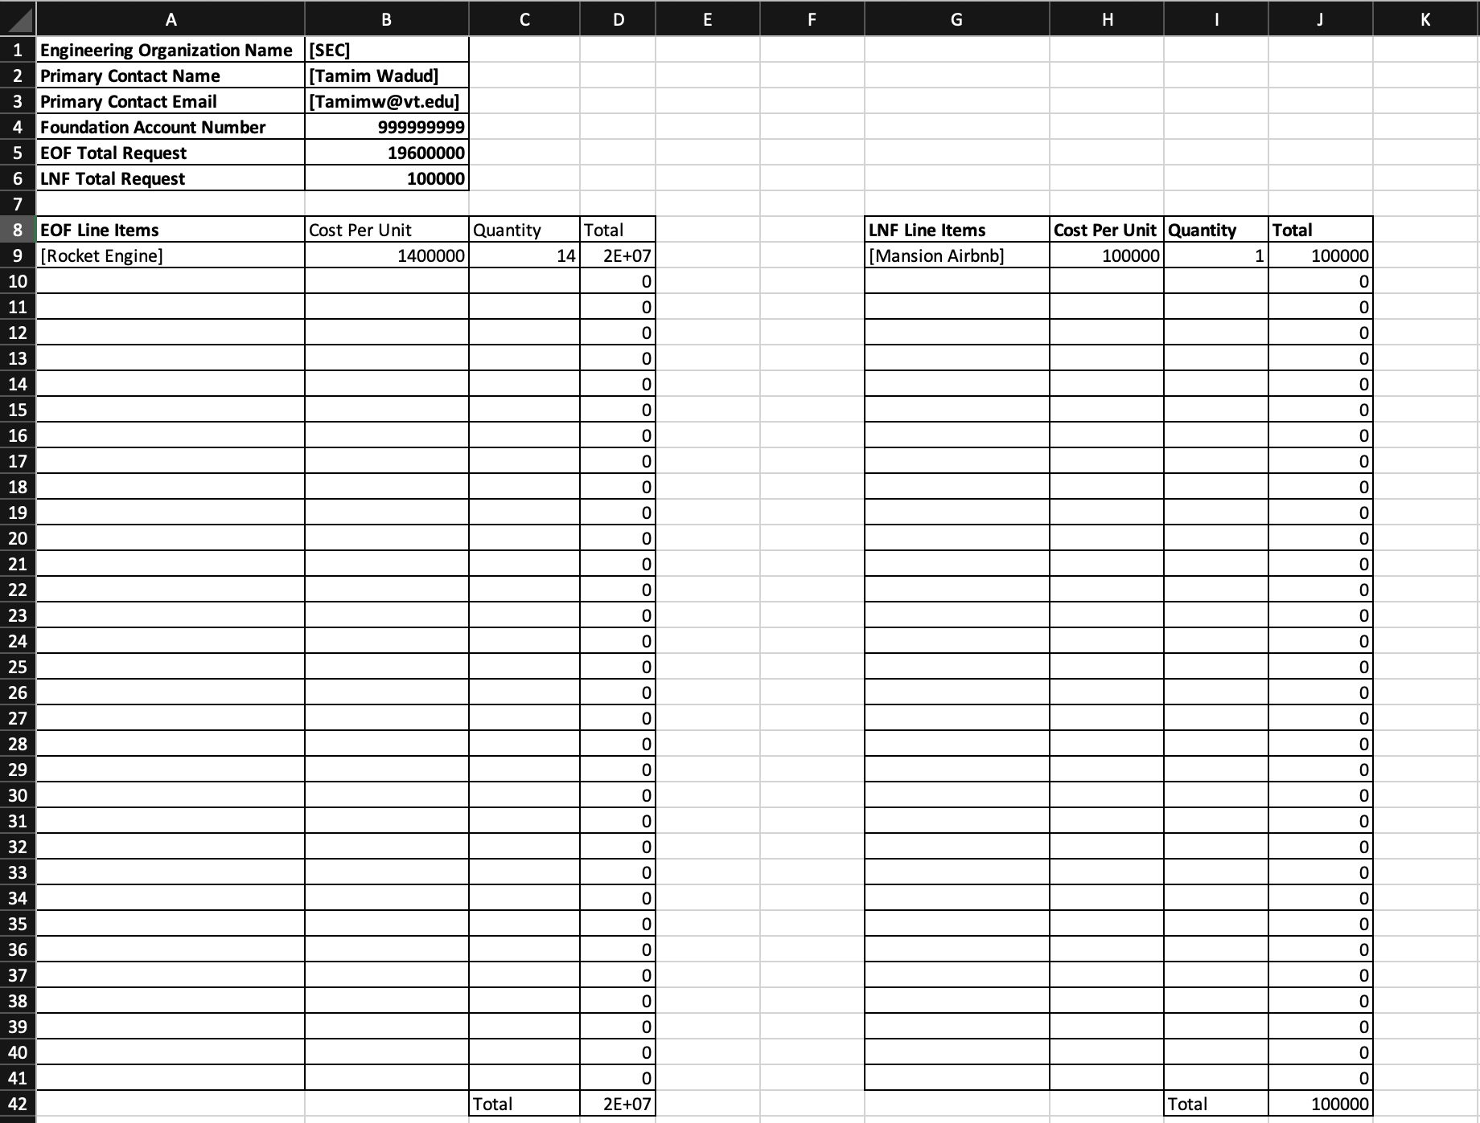
Excel Sheet for Application

Slide 18
Timeline
FEB 14th-19th
FEB 22nd
FEB 2nd
Feb 16th
Application Opens
Application Due
Follow-Up Period
Allocations Posted
Office Hours are available to help with the new application
No changes will be made past this date. No exceptions will be made.
If we require any further information from you regarding your application, Tamim will email you.
Allocations for both EOF and LNF will be posted by this date

Slide 19
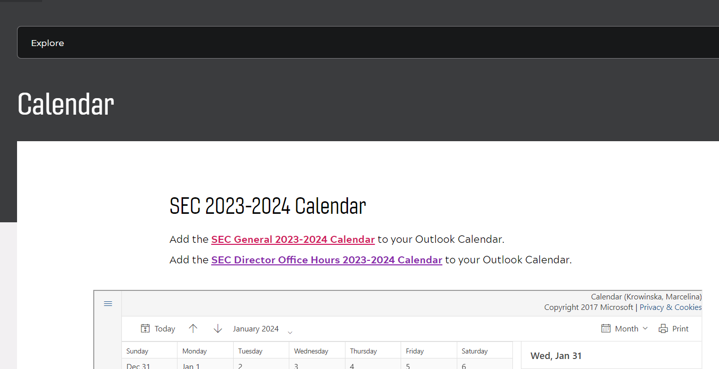
Office Hours Tues/Thurs 1pm - 3pm
Please add this to your calendar. All cancelled days will be updated on the calendar.

Slide 20
REMINDERS!
All line items for all of our funds (EOF, LNF, and IHF) are for items that have NOT YET BEEN PURCHASED
This includes housing for upcoming conferences, parts that have already been ordered, etc.
PLAN AHEAD! Try to apply for funding cycles a semester ahead

Slide 21
Spring 2023 EOF Extended to Feb 16th

Slide 22
Not meeting 75% rule!!!
American Institute of Chemical Engineers
BOLT
inspireFly
Institute of Industrial and Systems Engineers
Quality of Life Plus Student Chapter
SNAME/ASNE
Society of Hispanic Professional Engineers
Society of Women in Aviation and Space Exploration
Students for the Exploration & Development of Space

Slide 23
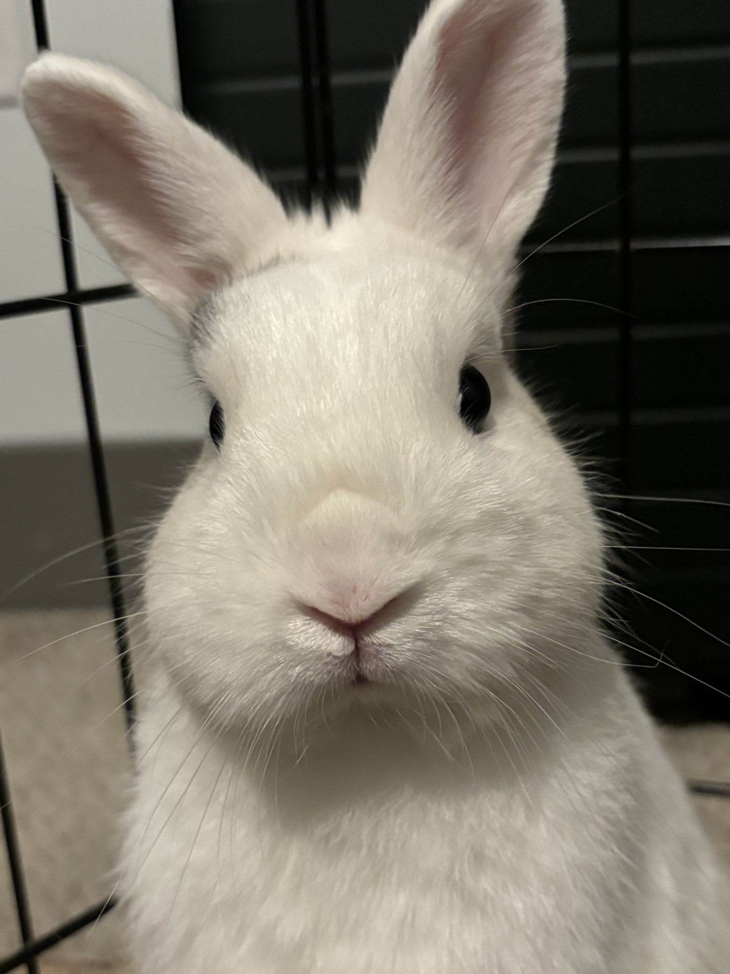
Questions

Slide 24
Save the Date
GAM #2: SEC Director Elections
Thursday, April 4th at 6:30 PM
Goodwin 190

